Slide 1
T20 tweets
Anupriya Balasubramanian

Slide 2
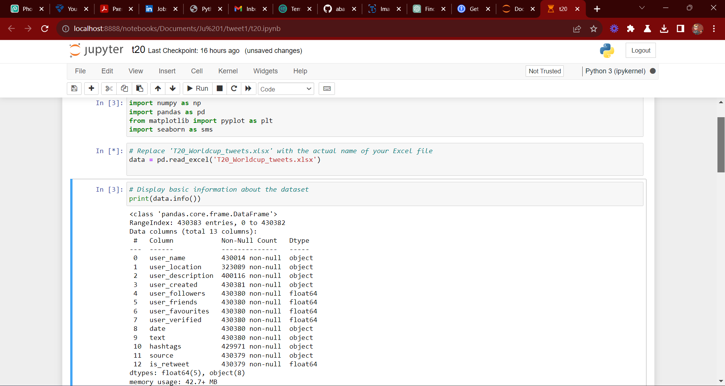
Import of packages

Slide 3
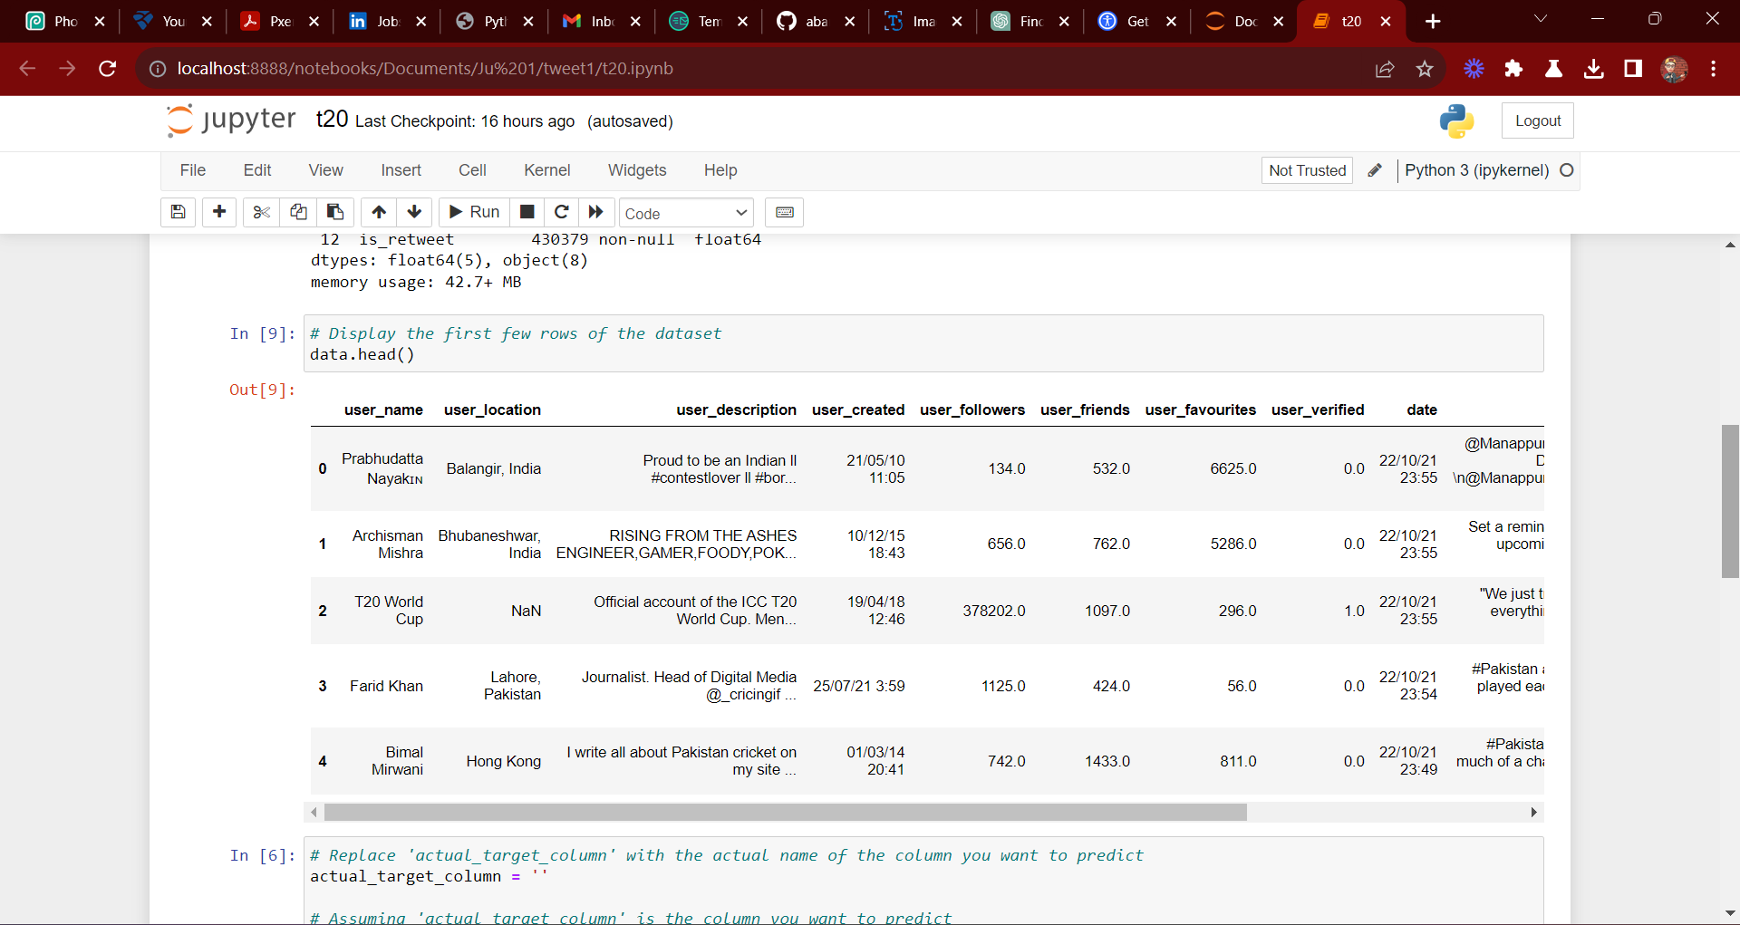
Table view

Slide 4
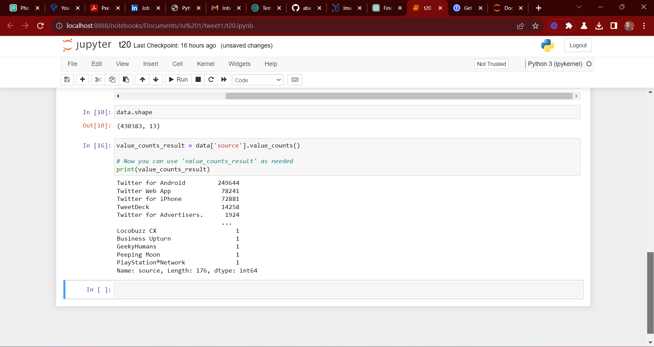
Count of Source column

Slide 5
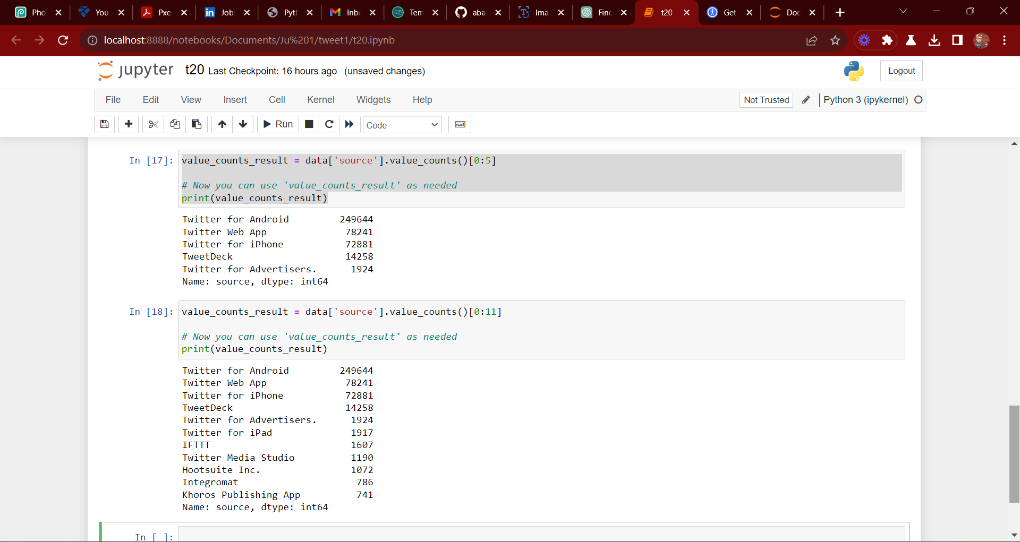
Adjusting the Source Column view

Slide 6
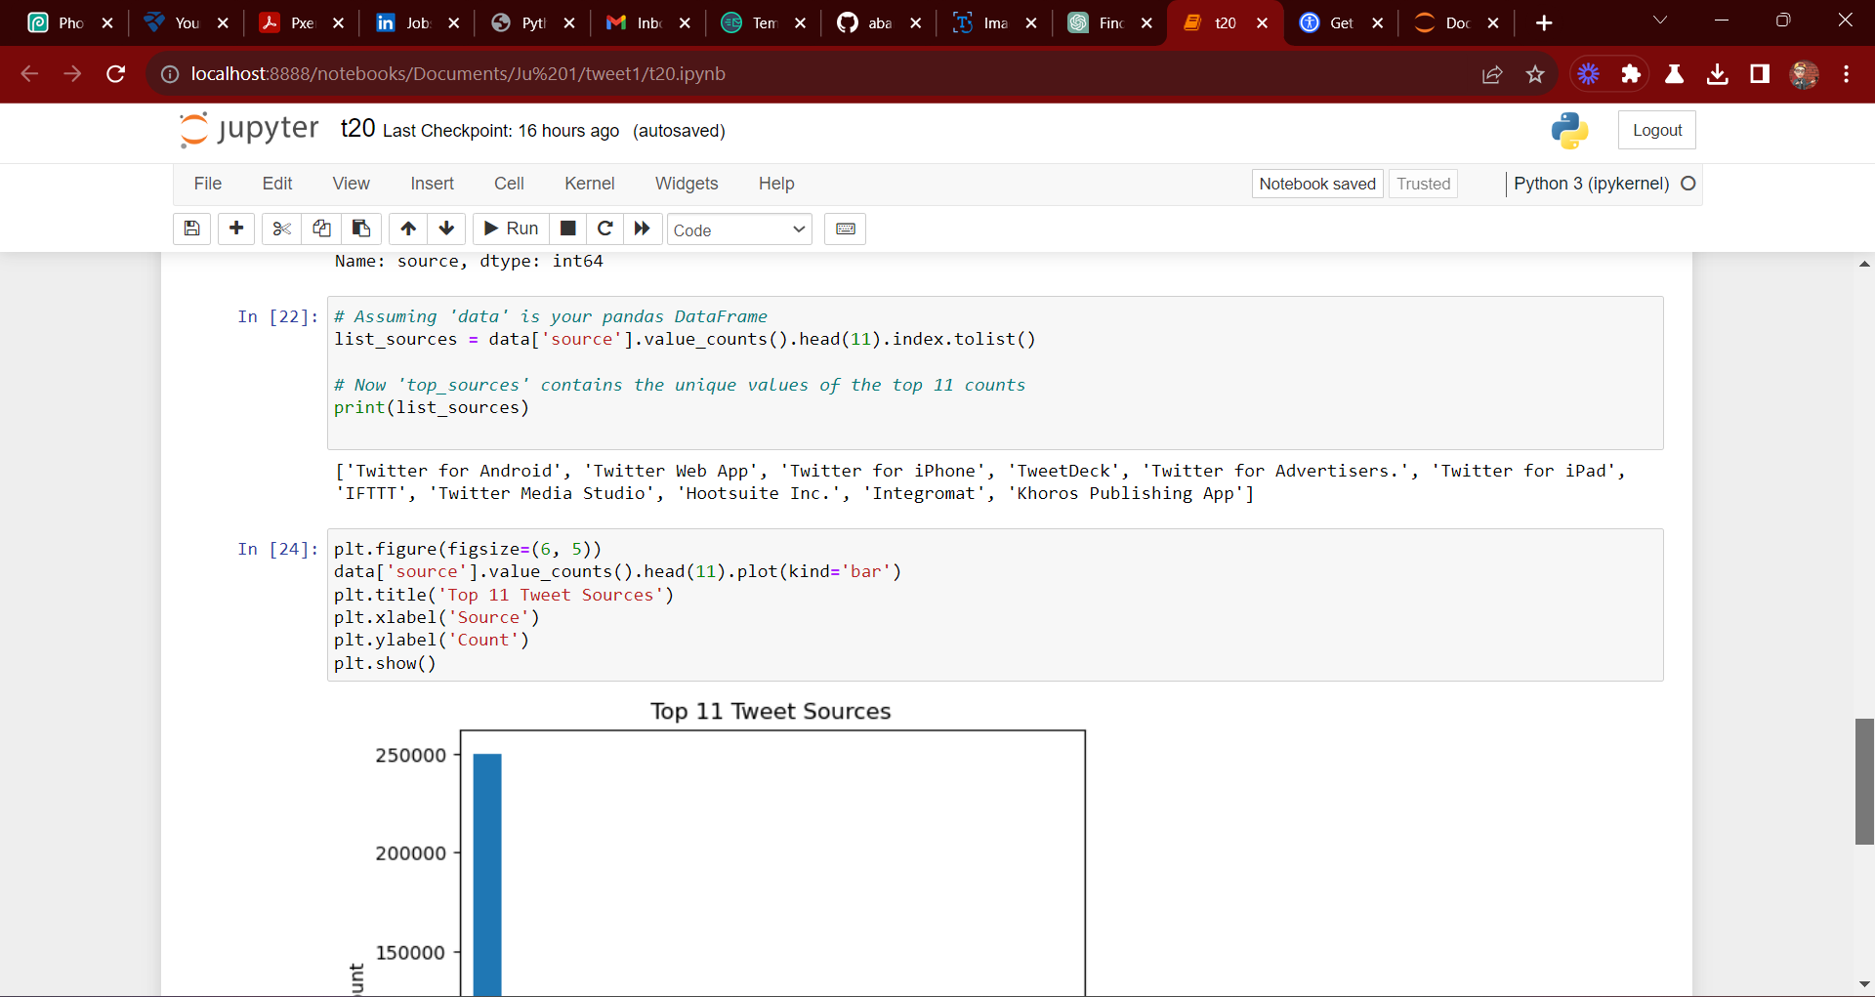
View of the Source names

Slide 7
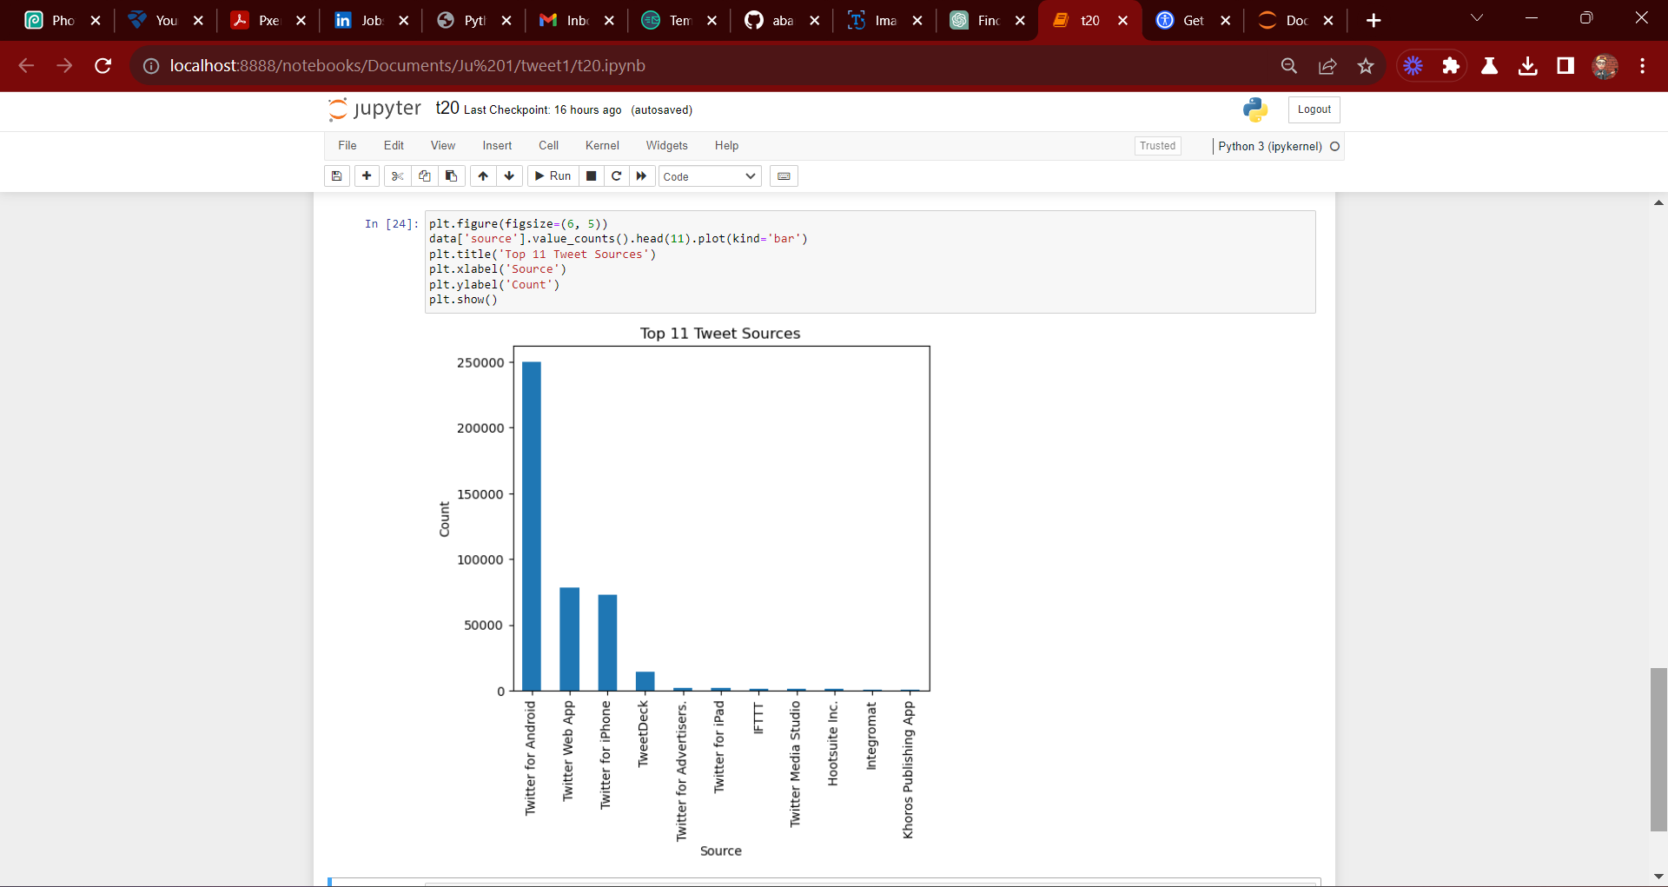
Bar chart of the Source

Slide 8
THANK YOU

